Slide 1

The Effect of the Corona Virus on the Import and Export of Products and Services in the World
Muhammed KOK
16750376746
Data Visualization Project

Slide 2
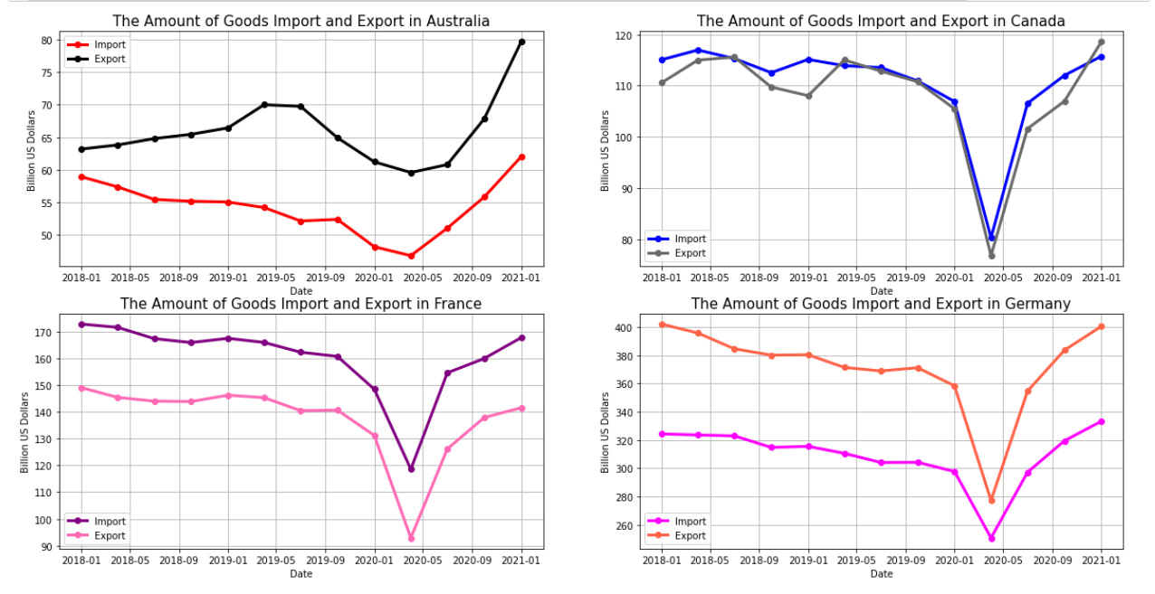

Slide 3
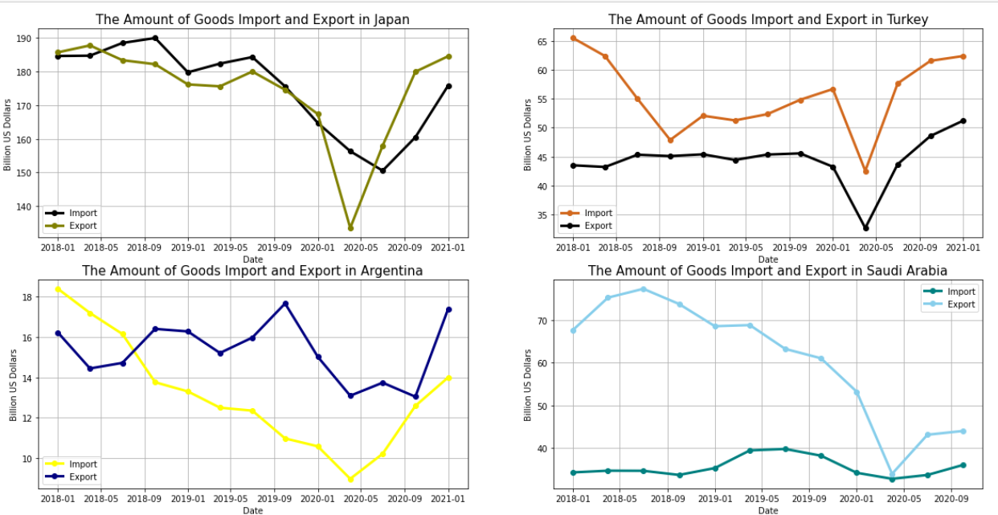

Slide 4
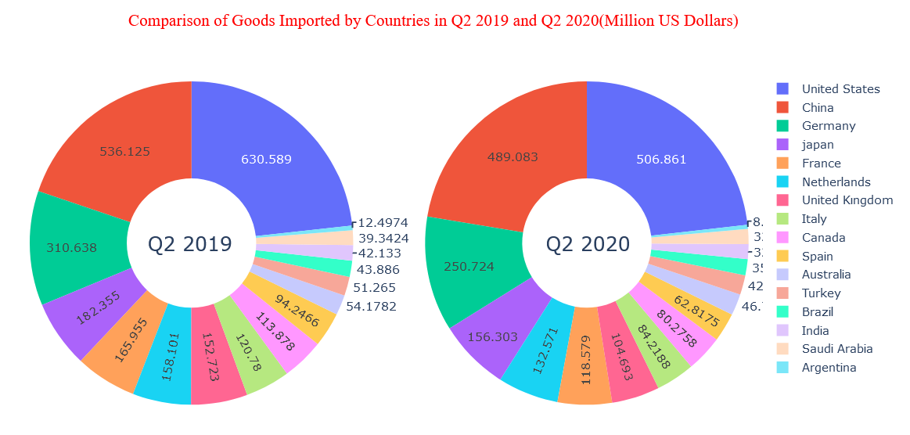

Slide 5
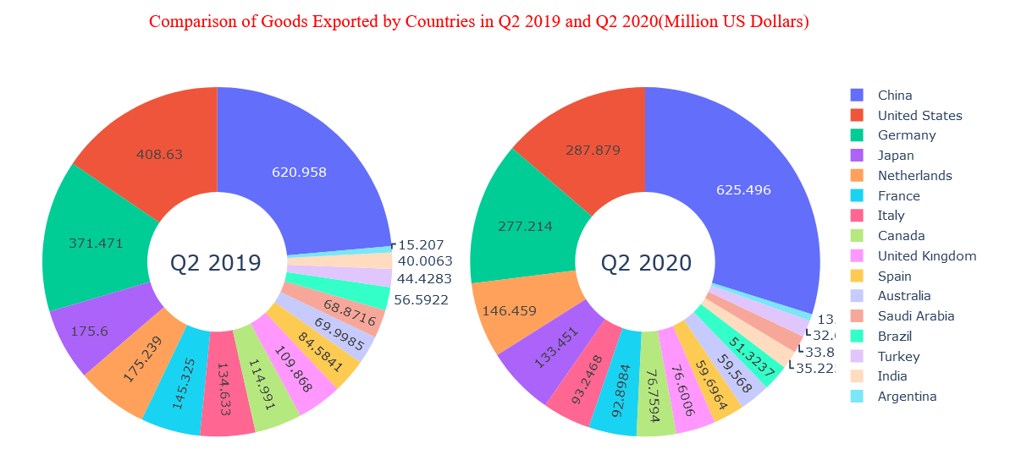

Slide 6
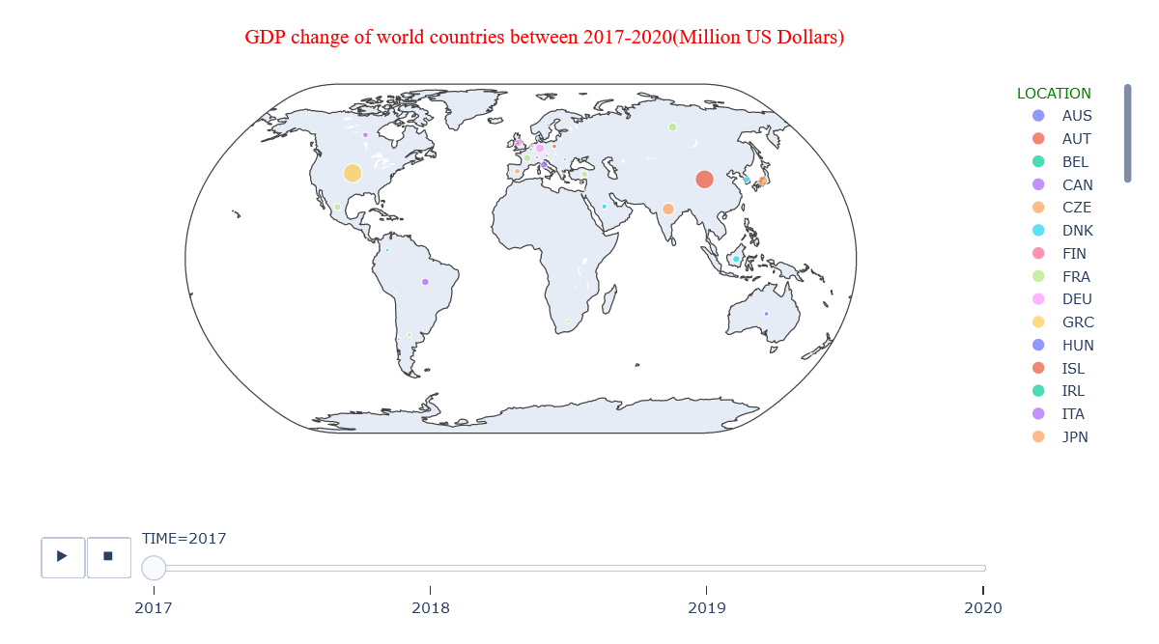

Slide 7
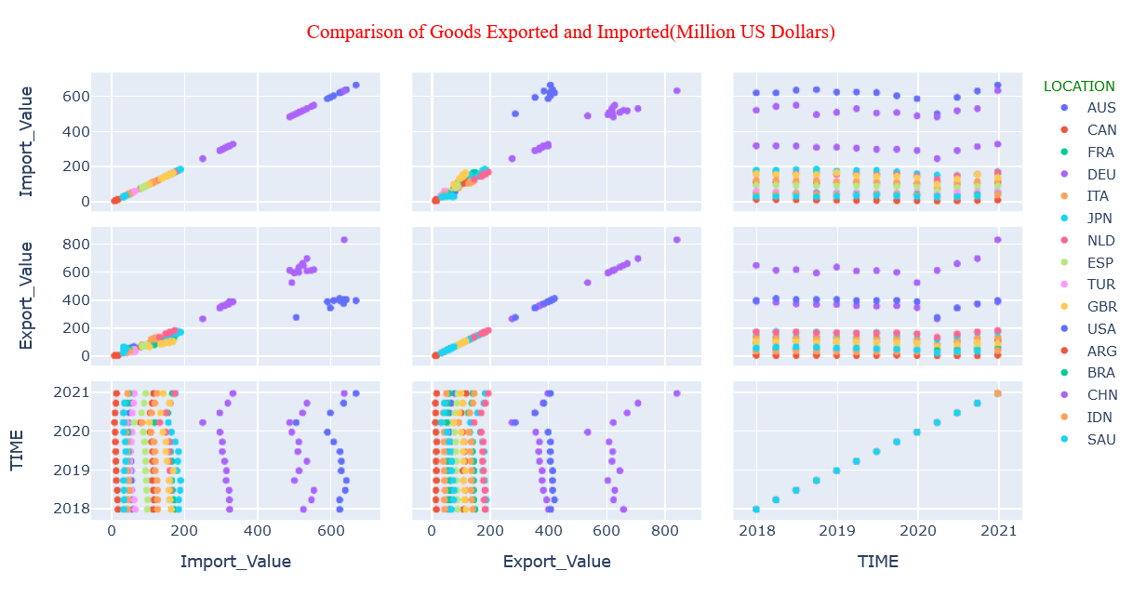

Slide 8
